Slide 1

Git Branching & Collaboration Workflow
Master the essential commands for efficient version control: branching, merging, .gitignore, and pulling updates
Presented by Tech Kares
Team Members :
Dhanush H Dilan B
Karthik
Sumaira Marzuqa Bashir Heera
Shifali K Salian

Slide 2

FUNDAMENTALS
Understanding Git Branches
What is a branch?
A branch is an independent line of development that allows you to work on features without affecting the main codebase. Think of it as creating a parallel universe where you can experiment safely.
Why use branches?
Develop features in isolation
Test changes without breaking production code
Collaborate with multiple team members simultaneously
Organise work into logical units

Slide 3
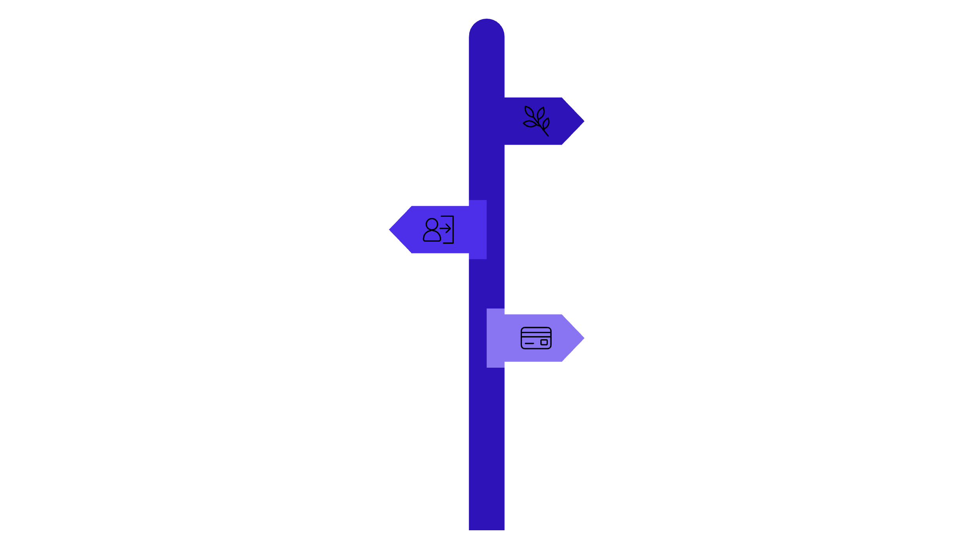



Branch Types in Practice
Main Branch
Feature Branch
Parallel Development
The production-ready code. Always stable and deployable. This is your single source of truth.
Created for specific features or fixes. Allows experimentation without risk to the main branch.
Multiple developers can work simultaneously on different branches without conflicts or interference.
Main Branch
Production-ready, always stable.
feature-login
Develop authentication feature in isolation.
feature-payment
Build payment integration separately.
Branches enable teams to work independently whilst maintaining code stability and organisation.

Slide 4
COMMANDS
Git Branch Commands
View All Branches
Create New Branch
git branch
git branch feature-name
Lists all local branches. The asterisk (*) indicates your current branch.
Creates a new branch but doesn't switch to it. You'll remain on your current branch.
Create & Switch
Delete Branch
git checkout -b feature-name
git branch -d feature-name
Creates a new branch and immediately switches to it. This is the most commonly used command.
Safely deletes a merged branch. Use -D to force delete an unmerged branch (use with caution).

Slide 5
Git Merging Explained
What is Merging?
Fast-Forward Merge
Three-Way Merge
Merging combines changes from different branches into one unified branch. It's how you integrate your feature work back into the main codebase.
Creates a new commit when both branches have diverged. Combines all changes intelligently.
Simple merge when no conflicting changes exist. Git moves the pointer forward.
Why Merging Matters
Integrates completed features
Maintains project history
Enables collaborative development
Preserves all changes safely
git merge branch-name

Slide 6


Handling Merge Conflicts
Conflicts occur when the same part of a file is modified in different branches. Git needs your help to decide which changes to keep.
01
02
Identify the Conflict
Edit the File
Git marks conflicts in your files with special markers: <<<<<<<, =======, and >>>>>>>
Open the conflicted file, remove the conflict markers, and choose which changes to keep or combine both versions
03
04
Stage the Resolution
Complete the Merge
After fixing conflicts, mark them as resolved: git add filename
Commit your resolution: git commit
Top tip: Communicate with your team to avoid conflicts. Pull changes frequently and merge often to keep conflicts small and manageable.

Slide 7
CONFIGURATION
The .gitignore File
What is .gitignore?
Common Examples
A special file that tells Git which files or directories to ignore. These files won't be tracked or included in your repository.
node_modules/
*.log
.env
__pycache__/
.DS_Store
dist/
build/
*.tmp
Why Ignore Files?
Protect sensitive data (passwords, API keys)
Exclude large or generated files
Keep repository clean and focused
Prevent unnecessary conflicts
Create a .gitignore file in your repository root and add patterns for files you want Git to ignore. Each line represents a pattern.

Slide 8


Git Pull: Staying Synchronised
What is Git Pull?
Why Pull Regularly?
Combines git fetch and git merge into one command. Downloads changes from the remote repository and integrates them into your current branch.
Stay up-to-date with team changes, reduce merge conflicts, and ensure you're building on the latest code. Pull before starting new work.
Standard Pull
Fetch Only
Manual Merge
git pull origin main
git fetch
git merge origin/main
Fetches and merges changes from the main branch
Downloads changes without merging them
Merges fetched changes into your branch

Slide 9





Complete Git Workflow
Follow these steps for efficient collaboration and version control in any project.
Commit changes
Create branch
Pull updates
Merge & ignore
Create Branch
Make Changes
Pull Updates
git checkout -b feature-name
Edit files, then git add and git commit
git pull origin main
Merge Branch
Push Changes
git checkout main then git merge feature-name
git push origin main

Slide 10

Thank You!!
Presented by Tech Kares

